Slide 1
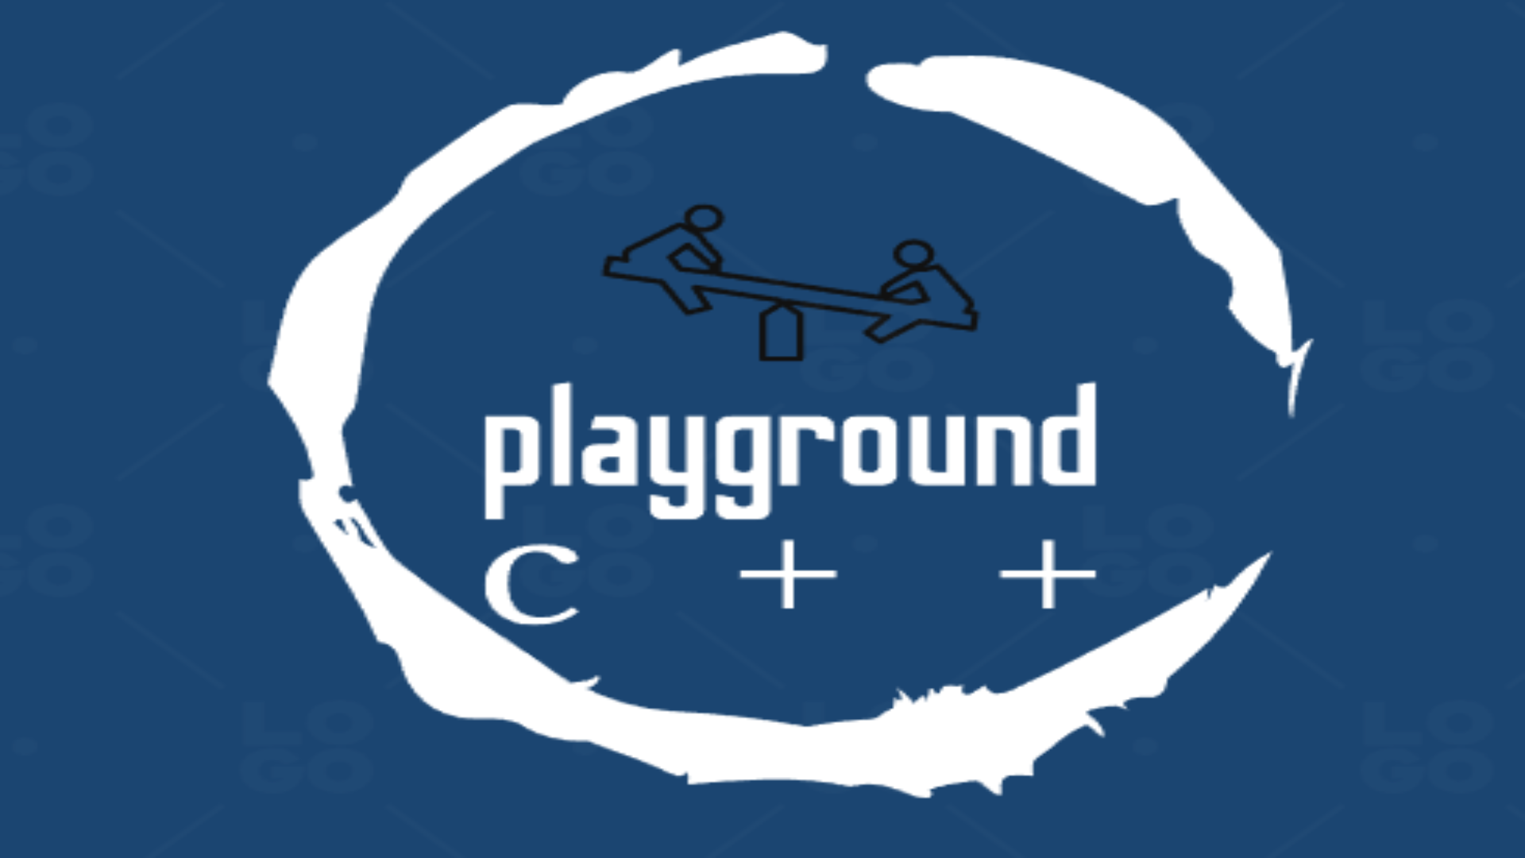

Slide 2
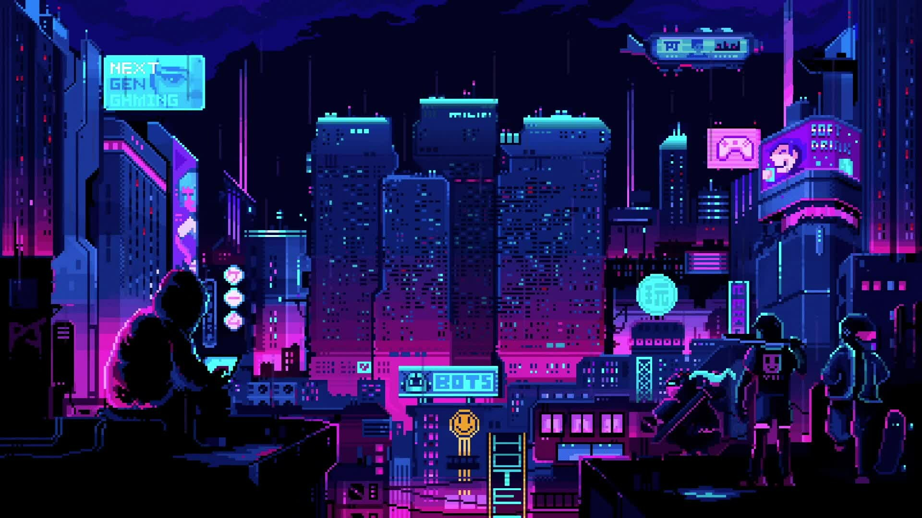




Table of contents
-----------
-----------
-----------

Slide 3

Team

Slide 4

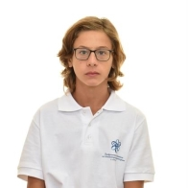
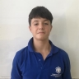
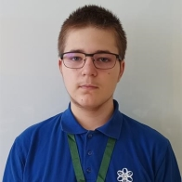
Team
Frontend developer
Backend developer
Scrum
QA
IVO Badalov
Stelyan nikolov
Martin belchev

Slide 5

Idea

Slide 6
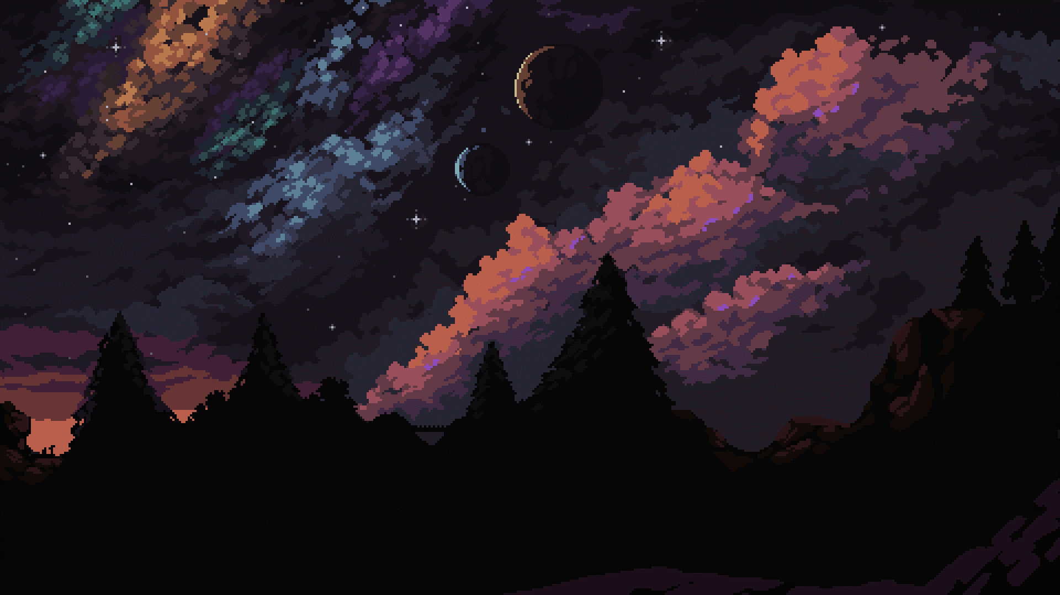
Idea
Our idea is to create a game, where the player needs to think before each action. That’s why we chose the game 2048. Our styling is retro-style, inspired by the games, created in the early 70s.

Slide 7

Tools

Slide 8
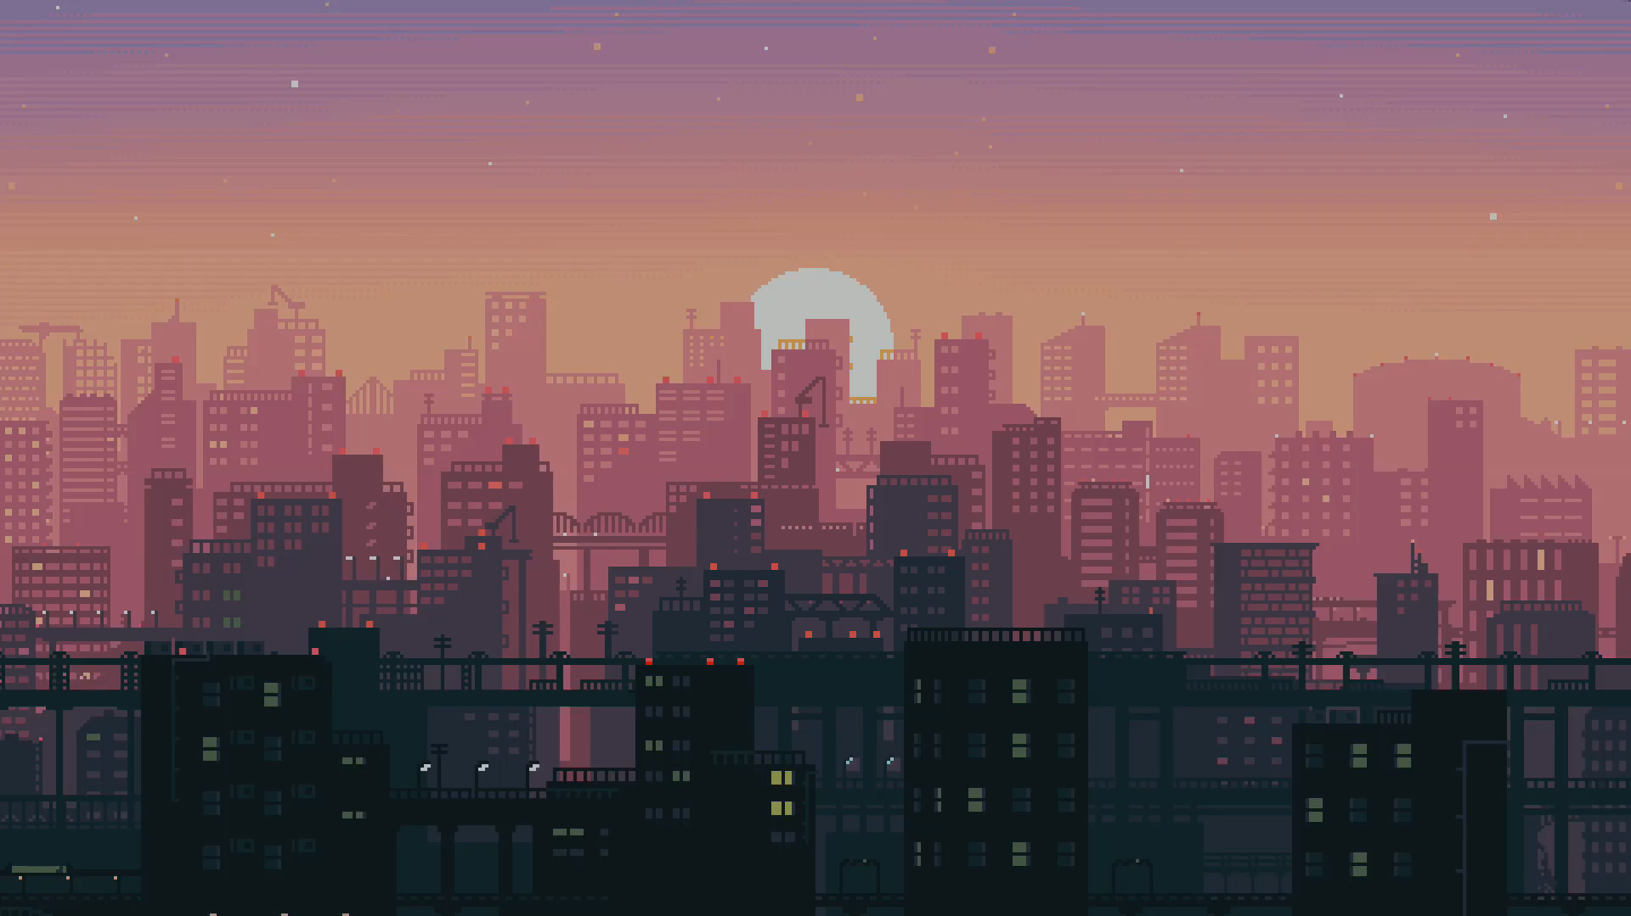





Tools

Slide 9

Realization

Slide 10
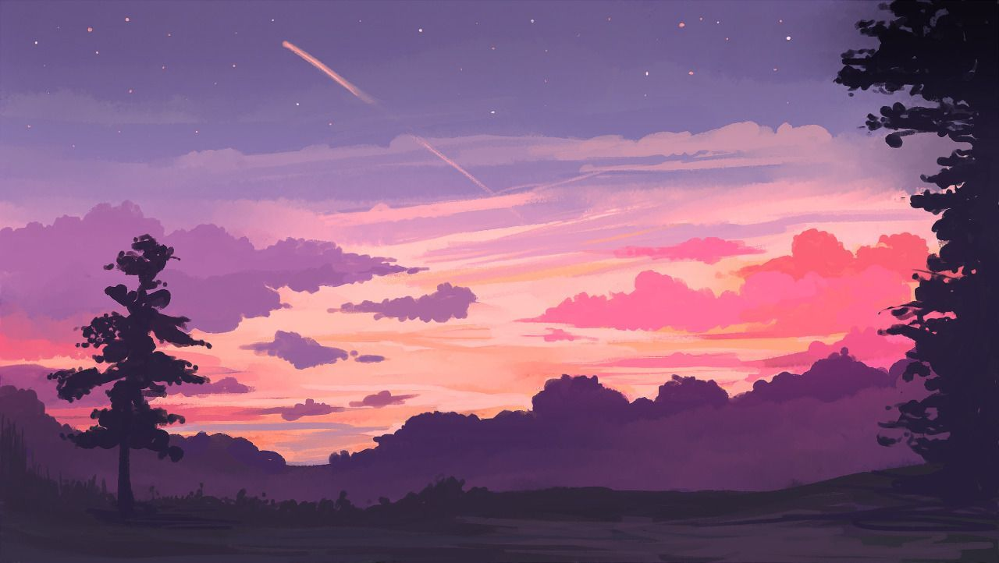
Realization
Team
Idea
Realization
Presentation

